Slide 1

NER4DUMMIES
Pablo Calleja
Ontology Engineering Group
Universidad Politécnica de Madrid, Spain
pcalleja@fi.upm.es
20/4/2018
Notes:
Cambiar la licencia por la que aplique.

Slide 2
Before we start
Copy the repo:
https://github.com/SerPablo/NER4Dummies
Notes:
This is a Hands-On presentation: the idea is to execute java projects

Slide 3
Why this tutorial?
There are a lot of tools available for NLP
Very useful without expert knowledge
… and they are not so difficult
But documentation could be a nightmare
There is lack of simple and direct examples
Notes:
This is a Hands-On presentation: the idea is to execute java projects

Slide 4
Scope of the presentation
Explain basic concepts
Present different tools developed in the area
Run the libraries with examples to annotate texts and to train models
Foundations of how models are trained are not explained
Notes:
This is a Hands-On presentation: the idea is to execute java projects

Slide 5
Index
Definitions
Tools
Corpus
Hands-on
Apache OpenNLP
Stanford CoreNLP
IxaPipes
GATE-ANNIE

Slide 6
1. Definitions. What is a named entity?
Named entity
Real-world concept denoted with a referent term or proper name.
Main types:
Organizations
Persons
Places
Temporal units
Numerical units
Amazon
George Washington
President Barack Obama
United States
5000 $
Biomedicine:
Diseases
Proteins
Genes
Substances
Lymphocytic leukemia

Slide 7

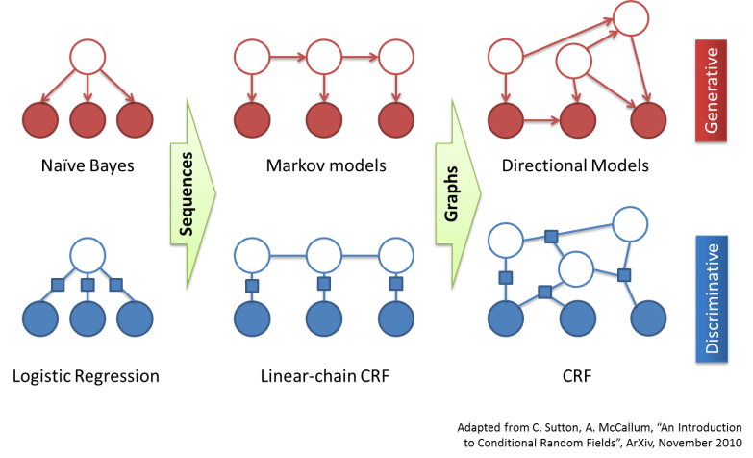


1. Definitions. What is named entity recognition?
Named entity recognition (and Classification)
Find each mention of a named entity in the text and label its type
Acronym: NER, NERC
Named entities in a natural language document
NER approaches
Linguistic Models
Probabilistic models
Rules
Gazetteers
Supervised machine learning
“Mr.” + { Mayus Noun}
Dictionaries
Training corpus
Algorithms

Slide 8

1. Definitions. Where NER is used?
NER is part of the information extraction processes
Information extraction aims to turn the unstructured information embedded in texts into structured data
Sentence
Segmentation
POS
Tagger
Named
Entity
Recognition
Co-reference Resolution
Tokenization
…
Unstructured documents
Structured
Information

Slide 9
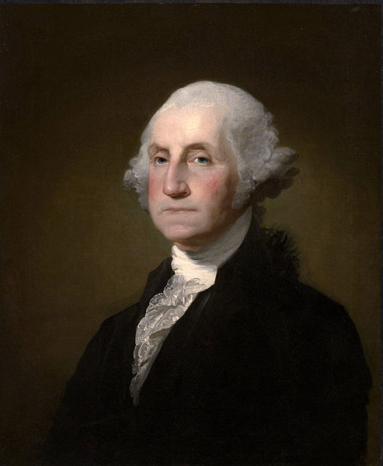
1. Definitions. What is NOT named entity recognition?
Named Entity Linking / Named Entity Disambiguation
Determining the identity of entities mentioned in text
Implies the use of a knowledge base
Acronyms: NEL,NED, NERD
George Washington was an American statesman and soldier who served as the first President of the United States from 1789 to 1797 and was one of the Founding Fathers of the United States.
http://dbpedia.org/page/George_Washington

Slide 10

1. Definitions. What is NOT named entity recognition?
Word Sense Disambiguation
Which sense of a word is used in a sentence, when the word has multiple meanings
Washington asked for advise from his cabinet, Jefferson and Randoph strongly opposed the new bank constitutionally, while Hamilton supported the bank
Noun:
http://babelnet.org/rdf/bank_EN/s00008364n

Slide 11
1. Definitions. What is NOT named entity recognition?
Co-reference resolution
Identify entities and pronouns in a text that refer to the same entity
George Washington was an American statesman and soldier who served as the first President of the United States from 1789 to 1797 and was one of the Founding Fathers of the United States. He served as Commander-in-Chief of the Continental Army during the American Revolutionary War, and later presided over the 1787 convention that drafted the United States Constitution.
Washington was born into the provincial gentry of Colonial Virginia to a family of wealthy planters who owned tobacco plantations and slaves, which he inherited….

Slide 12












2. Tools
600 repos

Slide 13


2. Tools. Basic functionalities
1)
Training
Training corpus
Model
Model 1
Model N
Predict / Execute
2)
Document
Document with
identified entities

Slide 14
3. Corpus. Representing entities
How entities could be represented in the training corpus or in the library output?

Slide 15

3. Corpus. MUC Format
Presented in the Message Understanding Conference 6
XML annotation
Types:
ENAMEX (Person, Location, Organization)
NUMEX (MONEY, PERCENT)
TIMEX (DATE, TIME)
Mr. <ENAMEX TYPE="PERSON"> Dooner </ENAMEX> met with <ENAMEX TYPE="PERSON"> Martin Puris</ENAMEX>, president and chief executive officer of <ENAMEX TYPE="ORGANIZATION">Ammirati & Puris </ENAMEX>, about <ENAMEX TYPE="ORGANIZATION"> McCann </ENAMEX>’s acquiring the agency with billings of <NUMEX TYPE="MONEY">$400 million</NUMEX>, but nothing has materialized.
Corpus: https://catalog.ldc.upenn.edu/LDC96T10
Grishman, R., & Sundheim, B. (1996). Message understanding conference-6: A brief history. In COLING 1996 Volume 1: The 16th International Conference on Computational Linguistics (Vol. 1).

Slide 16
3. Corpus. CONLL FORMAT
Presented in the Conference on Computational Natural Language Learning
Columns: Token - Annotation
Melbourne | B-LOC
( | O
Australia | B-LOC
) | O
. | O
Daryl | B-PER
Williams | I-PER
subrayó | O
BIO Annotation:
Daryl
Williams
subrayó
BEGIN
INSIDE
OUT
Corpus 2002: https://www.clips.uantwerpen.be/conll2002/ner/
Corpus 2003: https://www.clips.uantwerpen.be/conll2003/ner/

Slide 17
3. Corpus. Other Formats
BioCreative II
Sentences
Id | Text
P00001606T0076 | Comparison with alkaline phosphatases and 5-nucleotidase
Annotations
Id | Offsets | Span Text
P00001606T0076 | 14 33 | alkaline phosphatases
P00001606T0076 | 37 50 | 5-nucleotidase

Slide 18
NER4DUMMIES
Pablo Calleja
Ontology Engineering Group
Universidad Politécnica de Madrid, Spain
pcalleja@fi.upm.es
20/4/2018
Notes:
Cambiar la licencia por la que aplique.

Slide 19

Hands-on tutorial
Brace yourselves! Code is coming!

